Slide 1
ATHENA
Research on User Preferences

Slide 2
How can we improve our website?

Slide 3
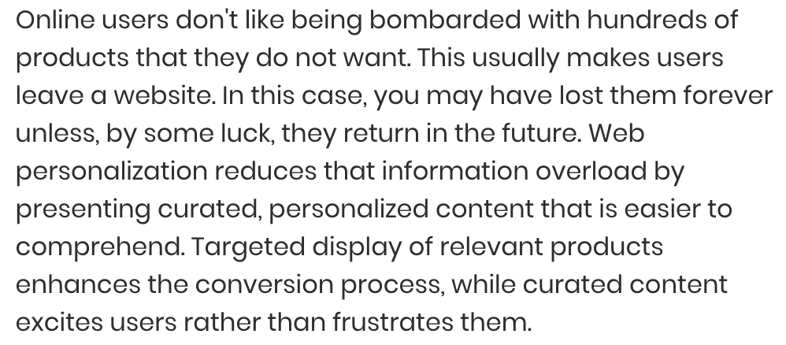
Personalization & Selective Information
Source: https://www.business.com
Notes:
https://www.business.com/articles/web-personalization-key-to-ecommerce-success/

Slide 4
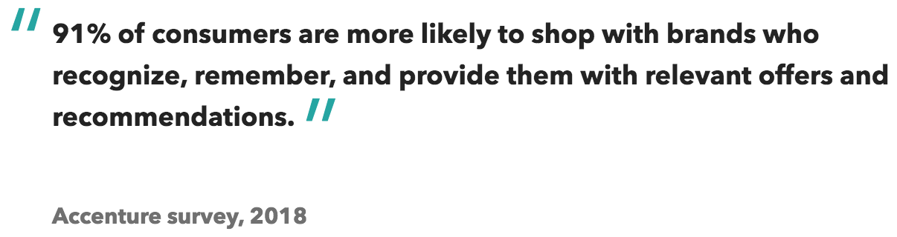
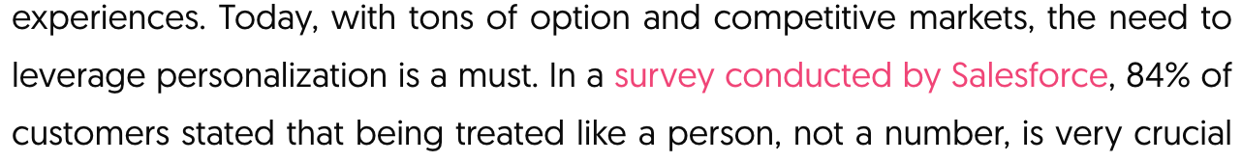
Personalization & Selective Information
Source: https://influencermarketinghub.com

Slide 5
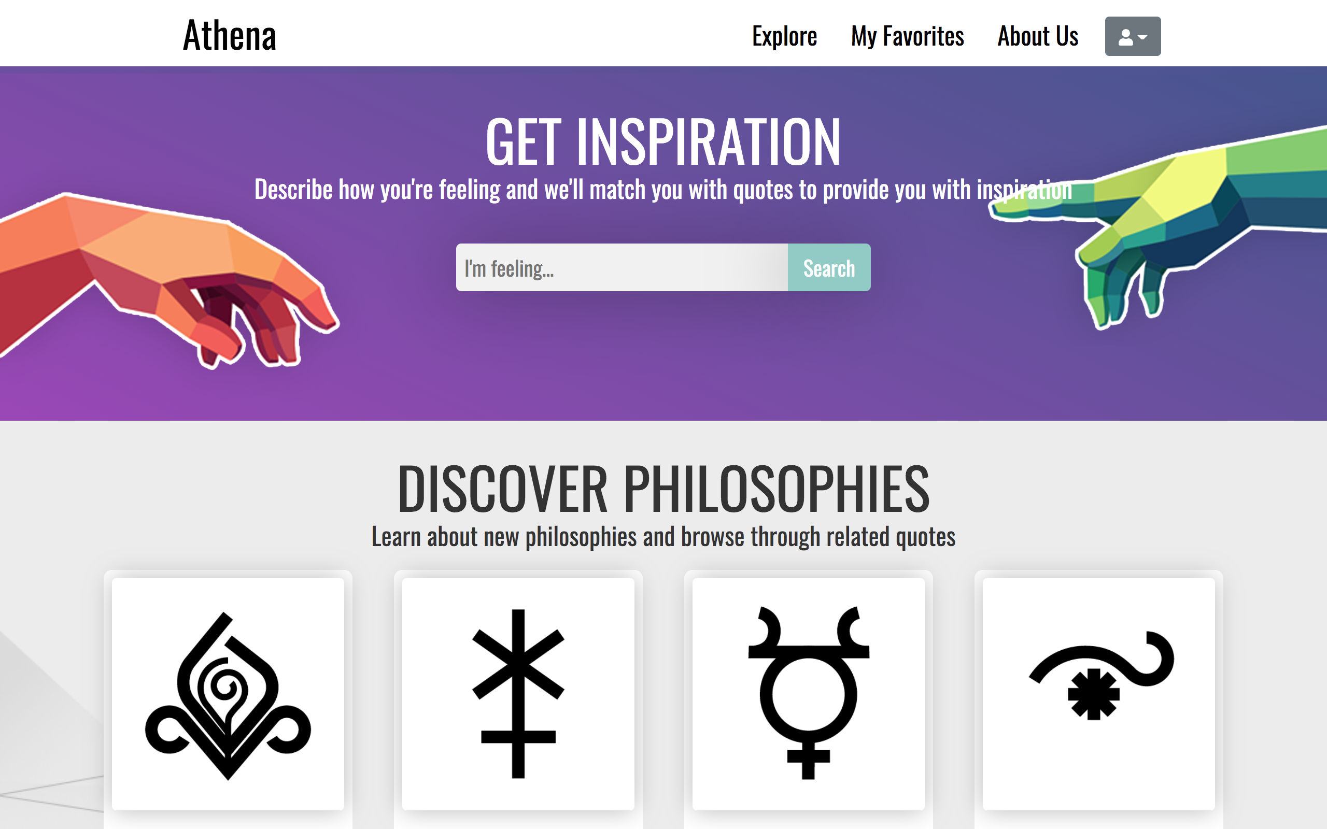

Slide 6
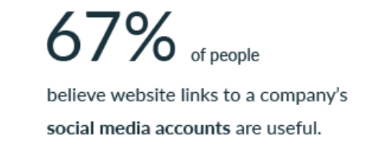
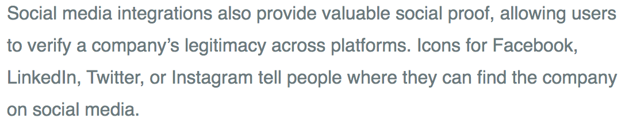
Brand Authority
Social Media
Notes:
https://clutch.co/web-designers/resources/top-6-website-features-people-value

Slide 7
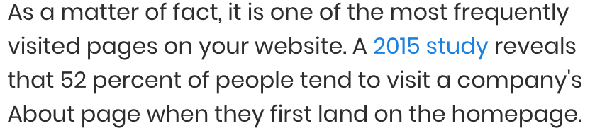
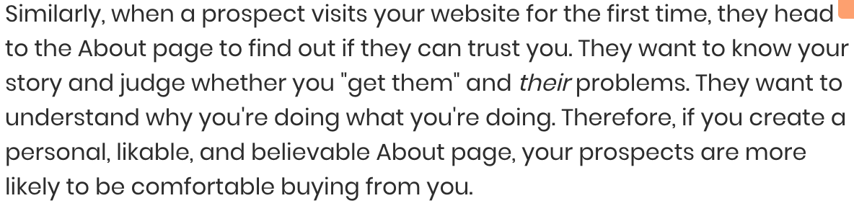
Brand Authority
About Us Page
Source: https://www.business.com

Slide 8


Brand Authority
Customer Reviews
Source: https://www.invespcro.com
Notes:
https://www.invespcro.com/blog/the-importance-of-online-customer-reviews-infographic/

Slide 9
Color Palette
“Colors alone influence up to 90% of an initial impression”
“Colors affect people’s behavior, mood, and stress levels”
“84.7% of consumers claim color is the primary draw card for the aesthetic of websites”
Source: https://review42.com/resources/color-psychology-facts/
Notes:
https://review42.com/resources/color-psychology-facts/

Slide 10
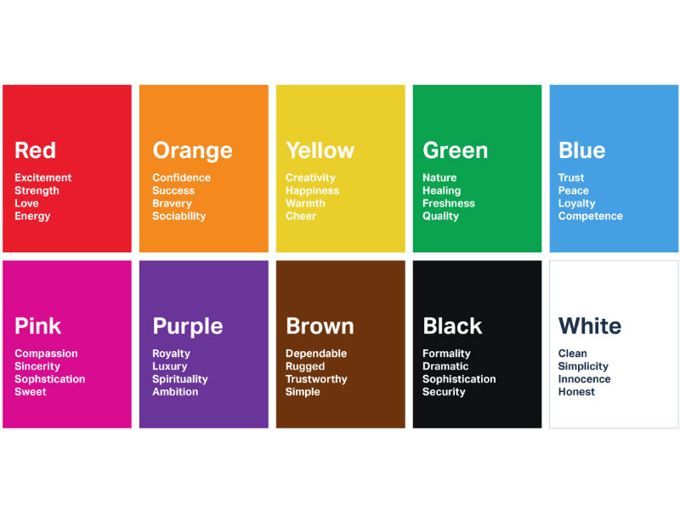

Slide 11
For Reference
https://www.calm.com

